Slide 1
TEAM Center Concept
Technology, Entrepreneurship, Advantage, and Makerspace
Together Everyone Achieves More

Slide 2
The Facilitating Our Future Series
Key Strategic Priorities
Housing Availability
Modernized Utility Infrastructure
Workforce Development
Public Safety
Downtown Revitalization and Corridor Beautification Projects

Slide 3
The Facilitating Our Future Series
The TEAM Center Concept is designed to help communities attract, nurture, maintain, and encourage startups or small businesses to enhance job creation and economic prosperity in alignment with identified strategic priorities.
Aligning and Investing in Relevant Technology
Encouraging and Empowering Entrepreneurship
Focusing On Strategic Advantages
Providing Makers With Resources
The TEAM Center is a location, a philosophy, and an economic culture for collaboration, information sharing, focused training, and innovation.

Slide 4
The Facilitating Our Future Series
The TEAM Center Concept Helps:
Leverage available and potentially underutilized resources.
Identify and attract investment opportunities that drive economic growth.
Create a purposeful socialized environment for learning, sharing, building, communicating, and testing ideas, knowledge, and projects.
Enhance new business formation that expands the equity of the community in relevant, aligned, desired, and focused economic development.

Slide 5
The Facilitating Our Future Series
Strategic Overview of the TEAM Center Concept Focuses:
Technology: The businesses, products, services, and infrastructure that make life easier or solve community problems.
Entrepreneurship: The people, businesses, products, and services that exploit opportunity for the purpose of creating value, delivering value, and capturing value.
Advantage: The specific economics, location, scale, raw materials, or unique resources, assets, or capabilities that provide the community with superiority against market rivals.
Makerspace: The facilities and platform where the community can share interests, gather to work on projects, exchange ideas, engage special equipment, or increase skills, techniques, and knowledge.

Slide 6
The Facilitating Our Future Series
Essential Steps to Create the TEAM Center Concept:
Identification: Assess the as-is state of the community in relation to each of the four pillars.
Specification: Estimate the facilities, programs, demand, and funding.
Acquisition: The process of obtaining the facilities, equipment, partners, and community support.
Exploitation: Planning and modeling the business performance to include management, marketing, procedures, obligations, and accountability.
Operation: Launching and operating the functional center to serve the community.

Slide 7
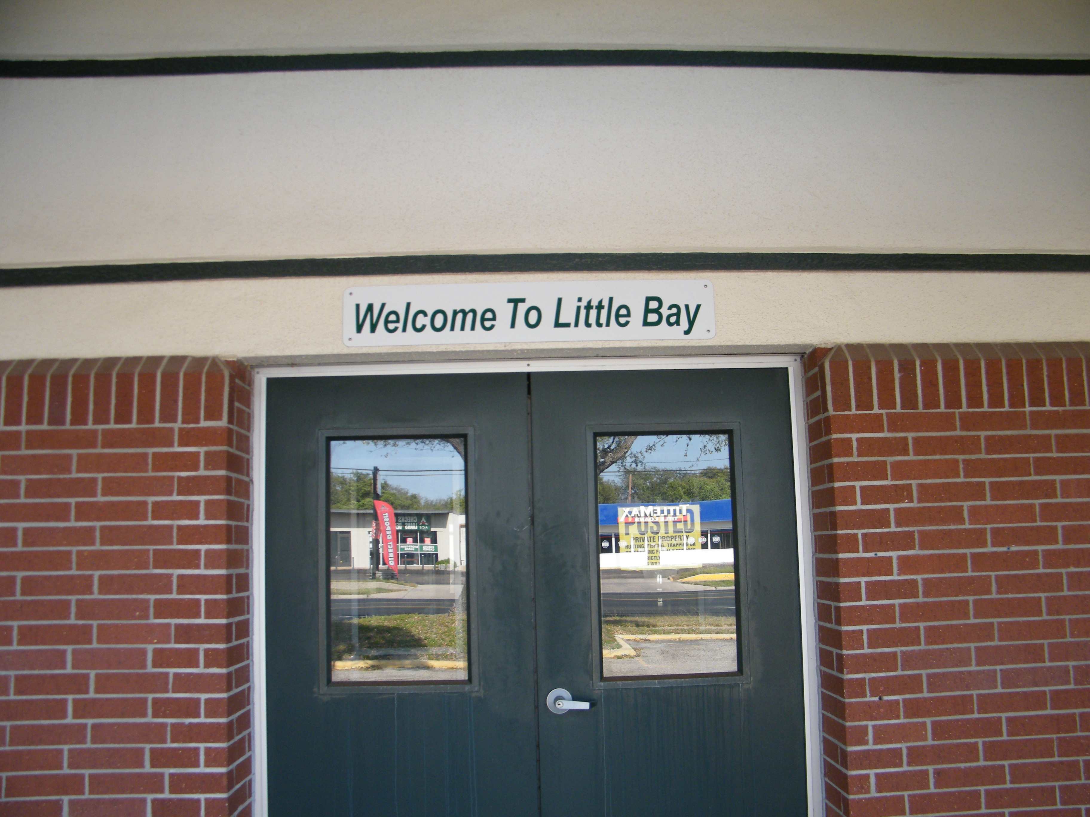
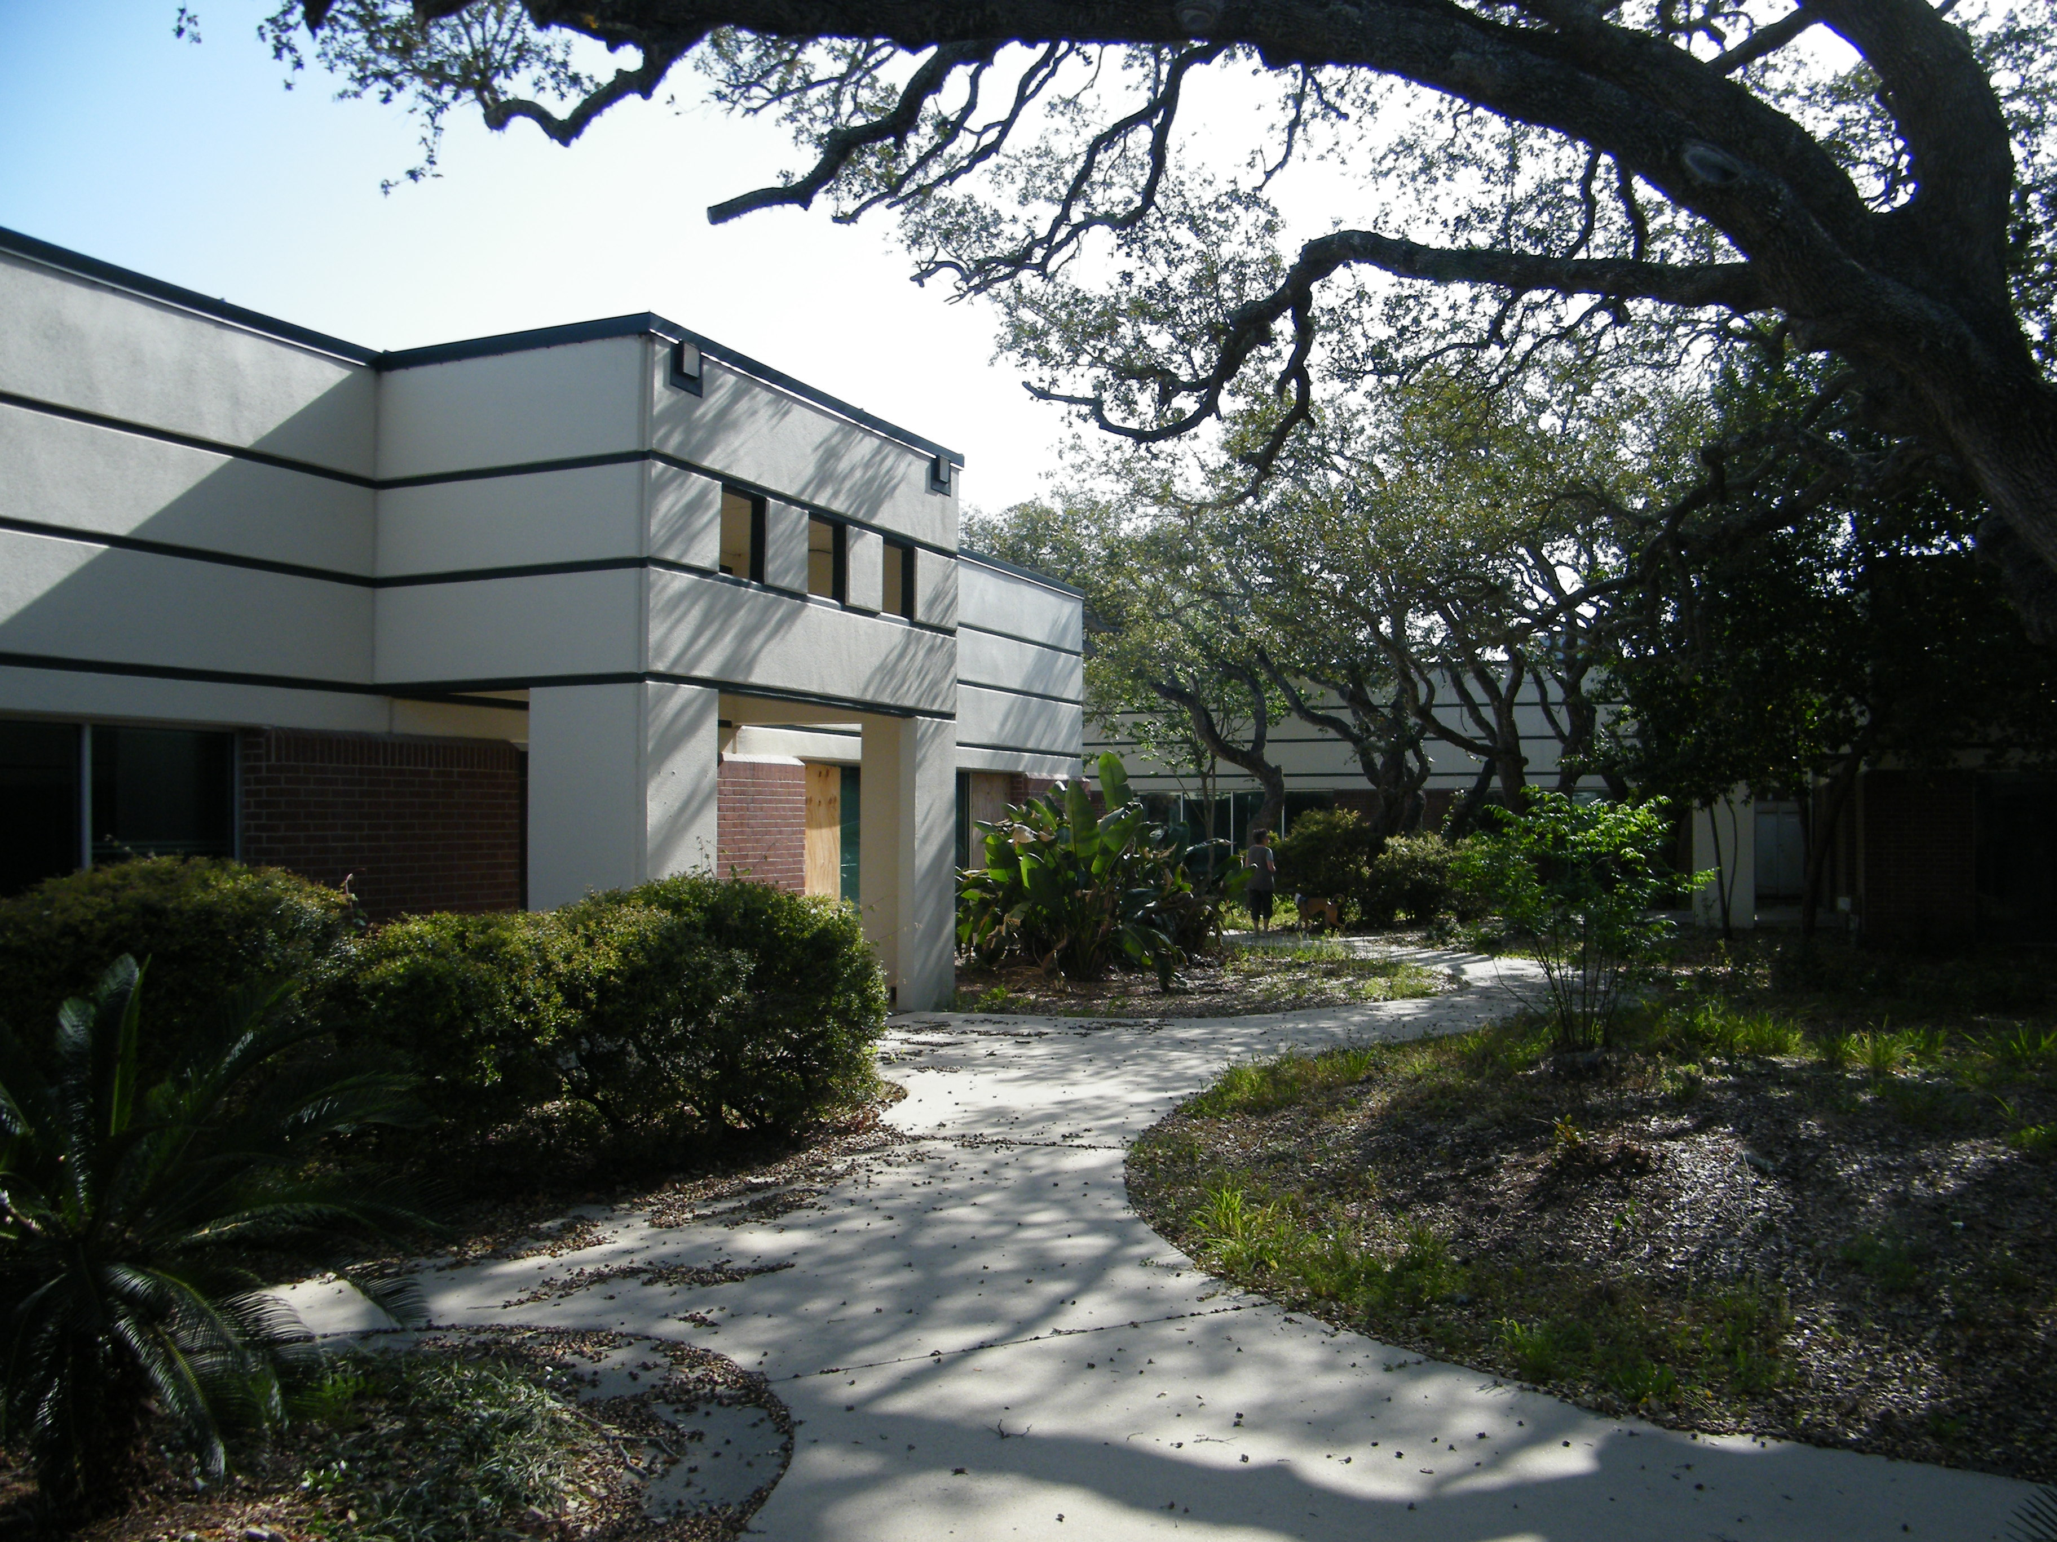
The Facilitating Our Future Series

Slide 8
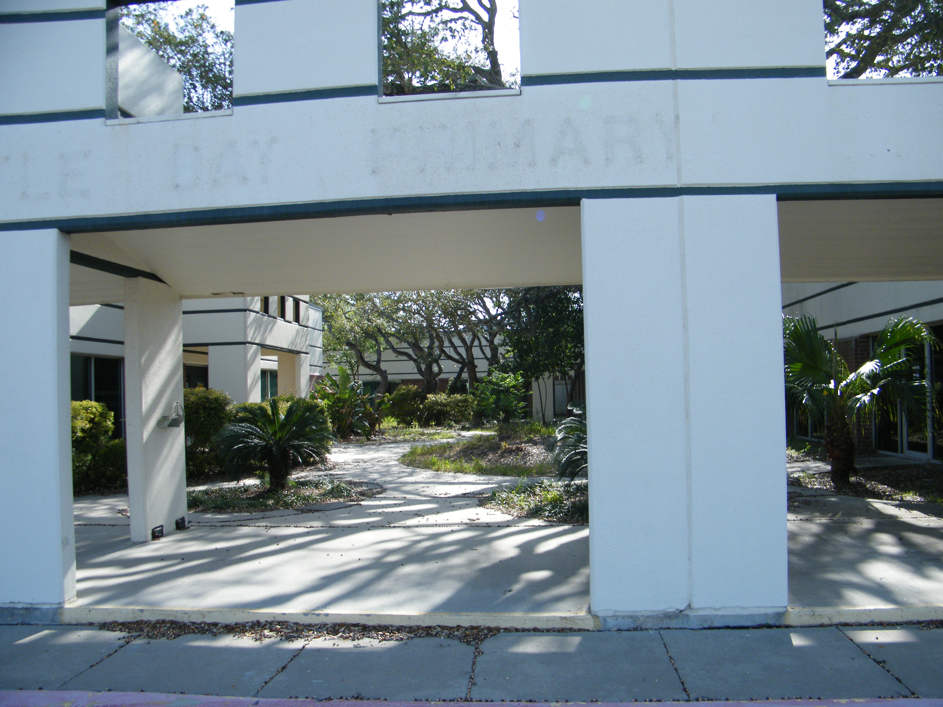
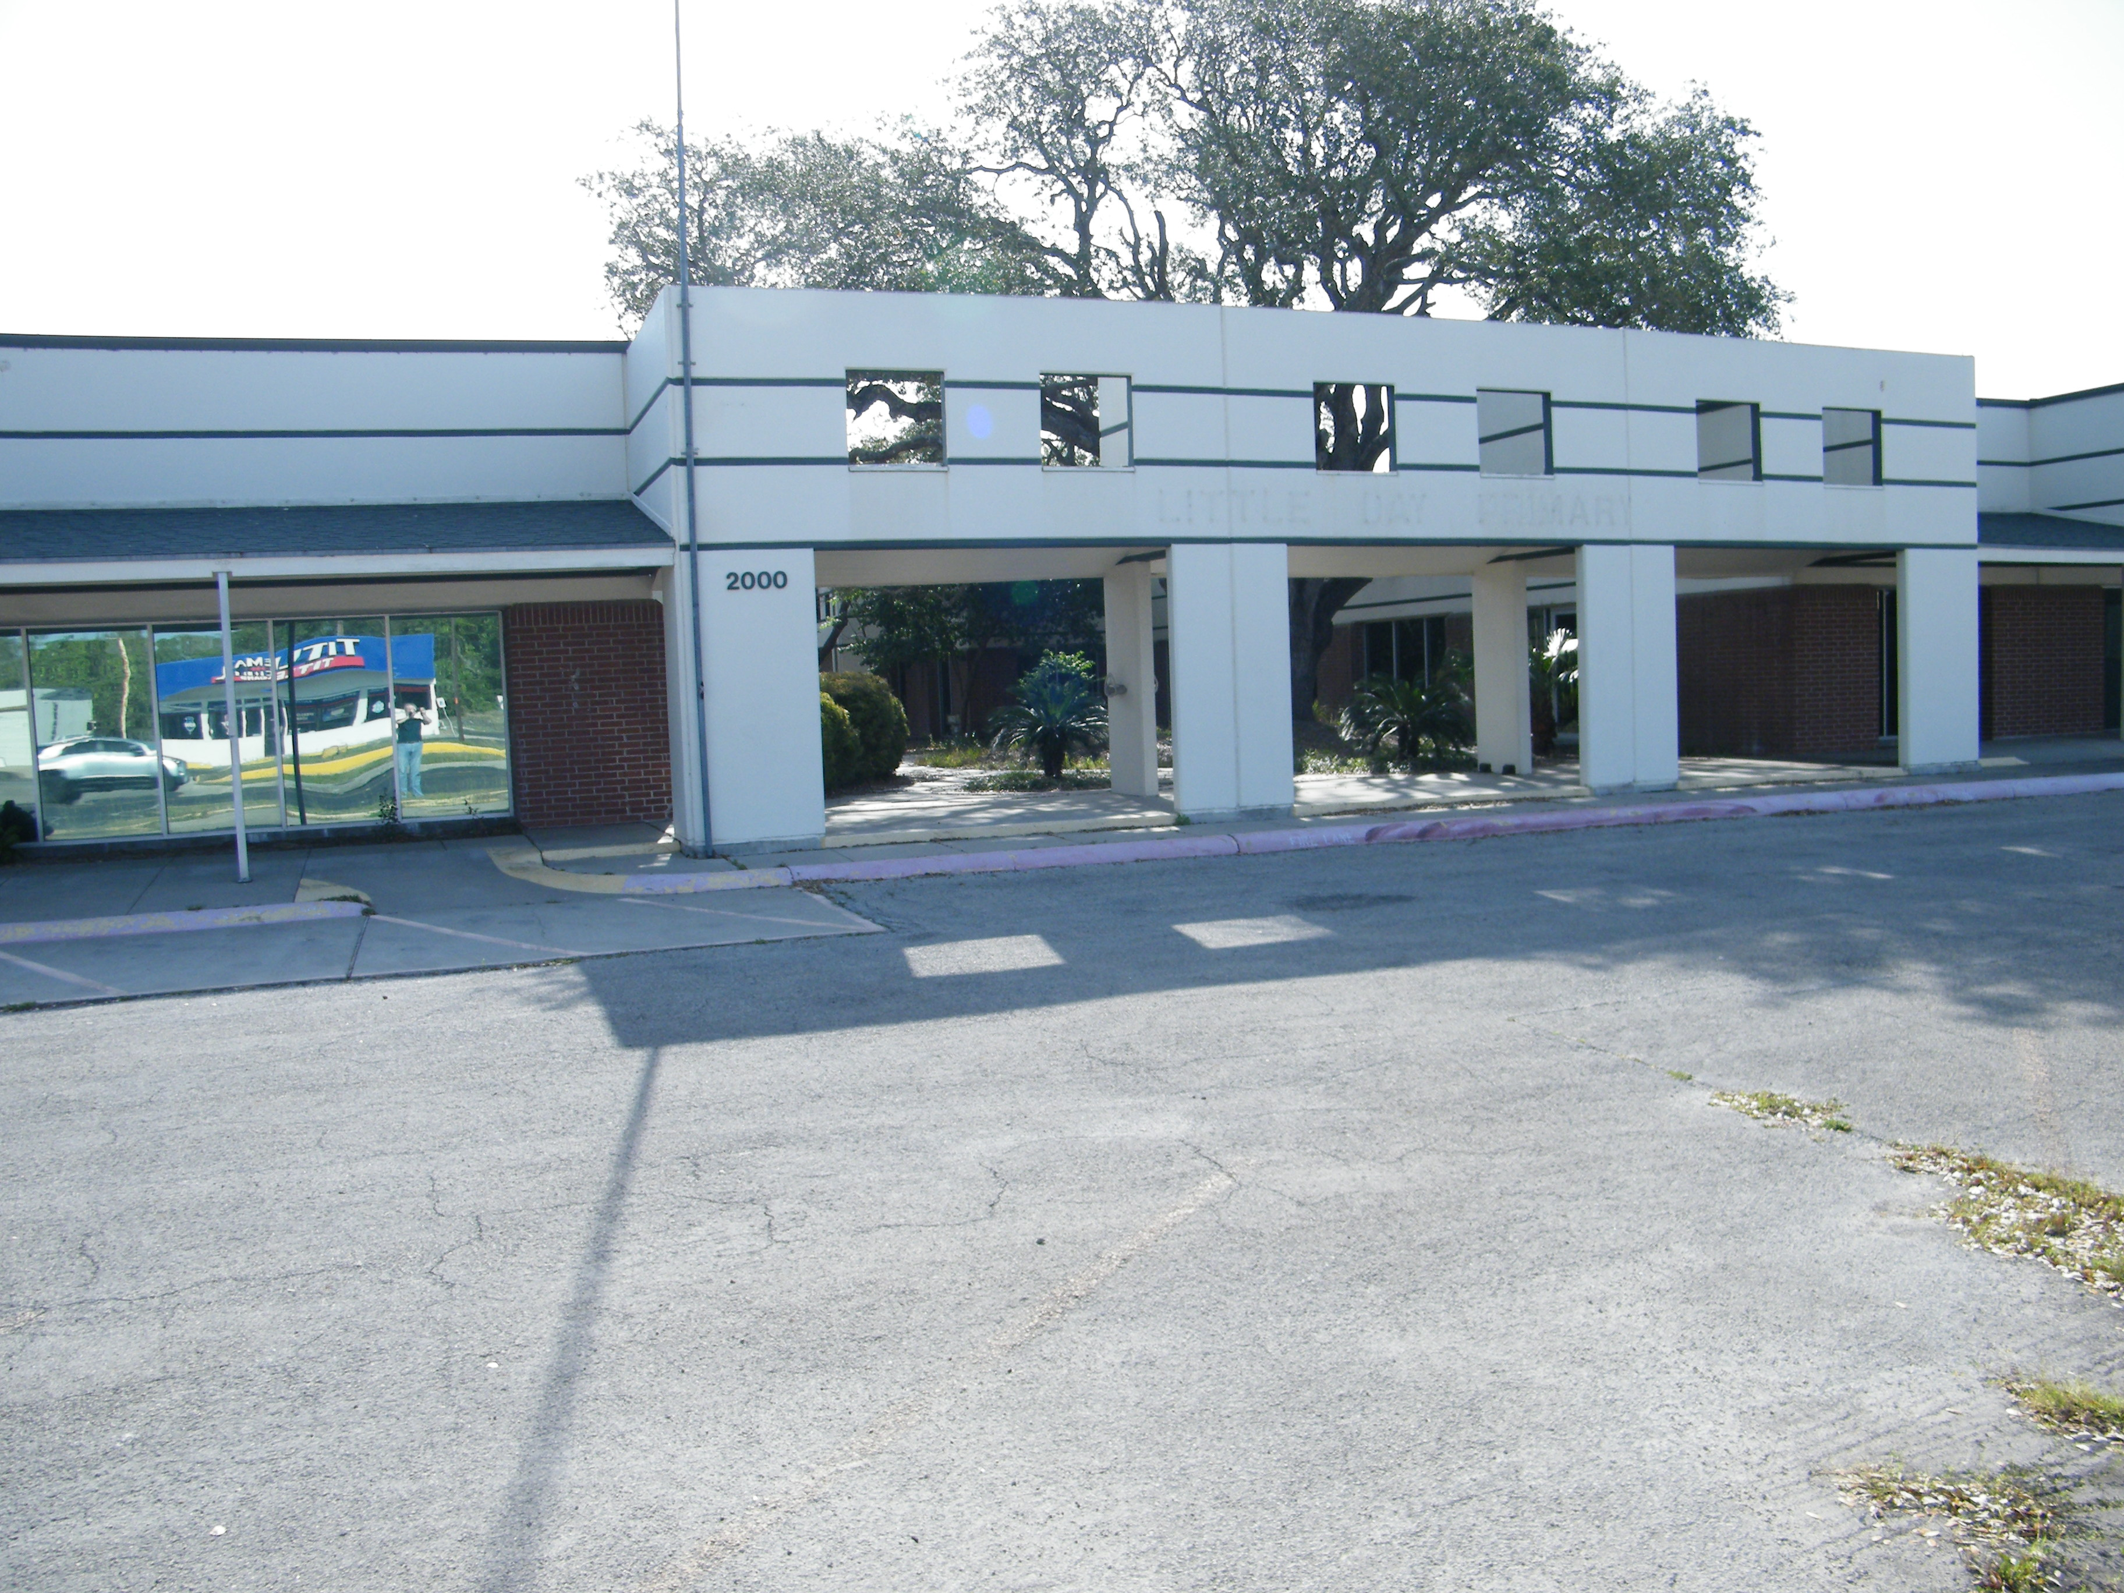
The Facilitating Our Future Series

Slide 9
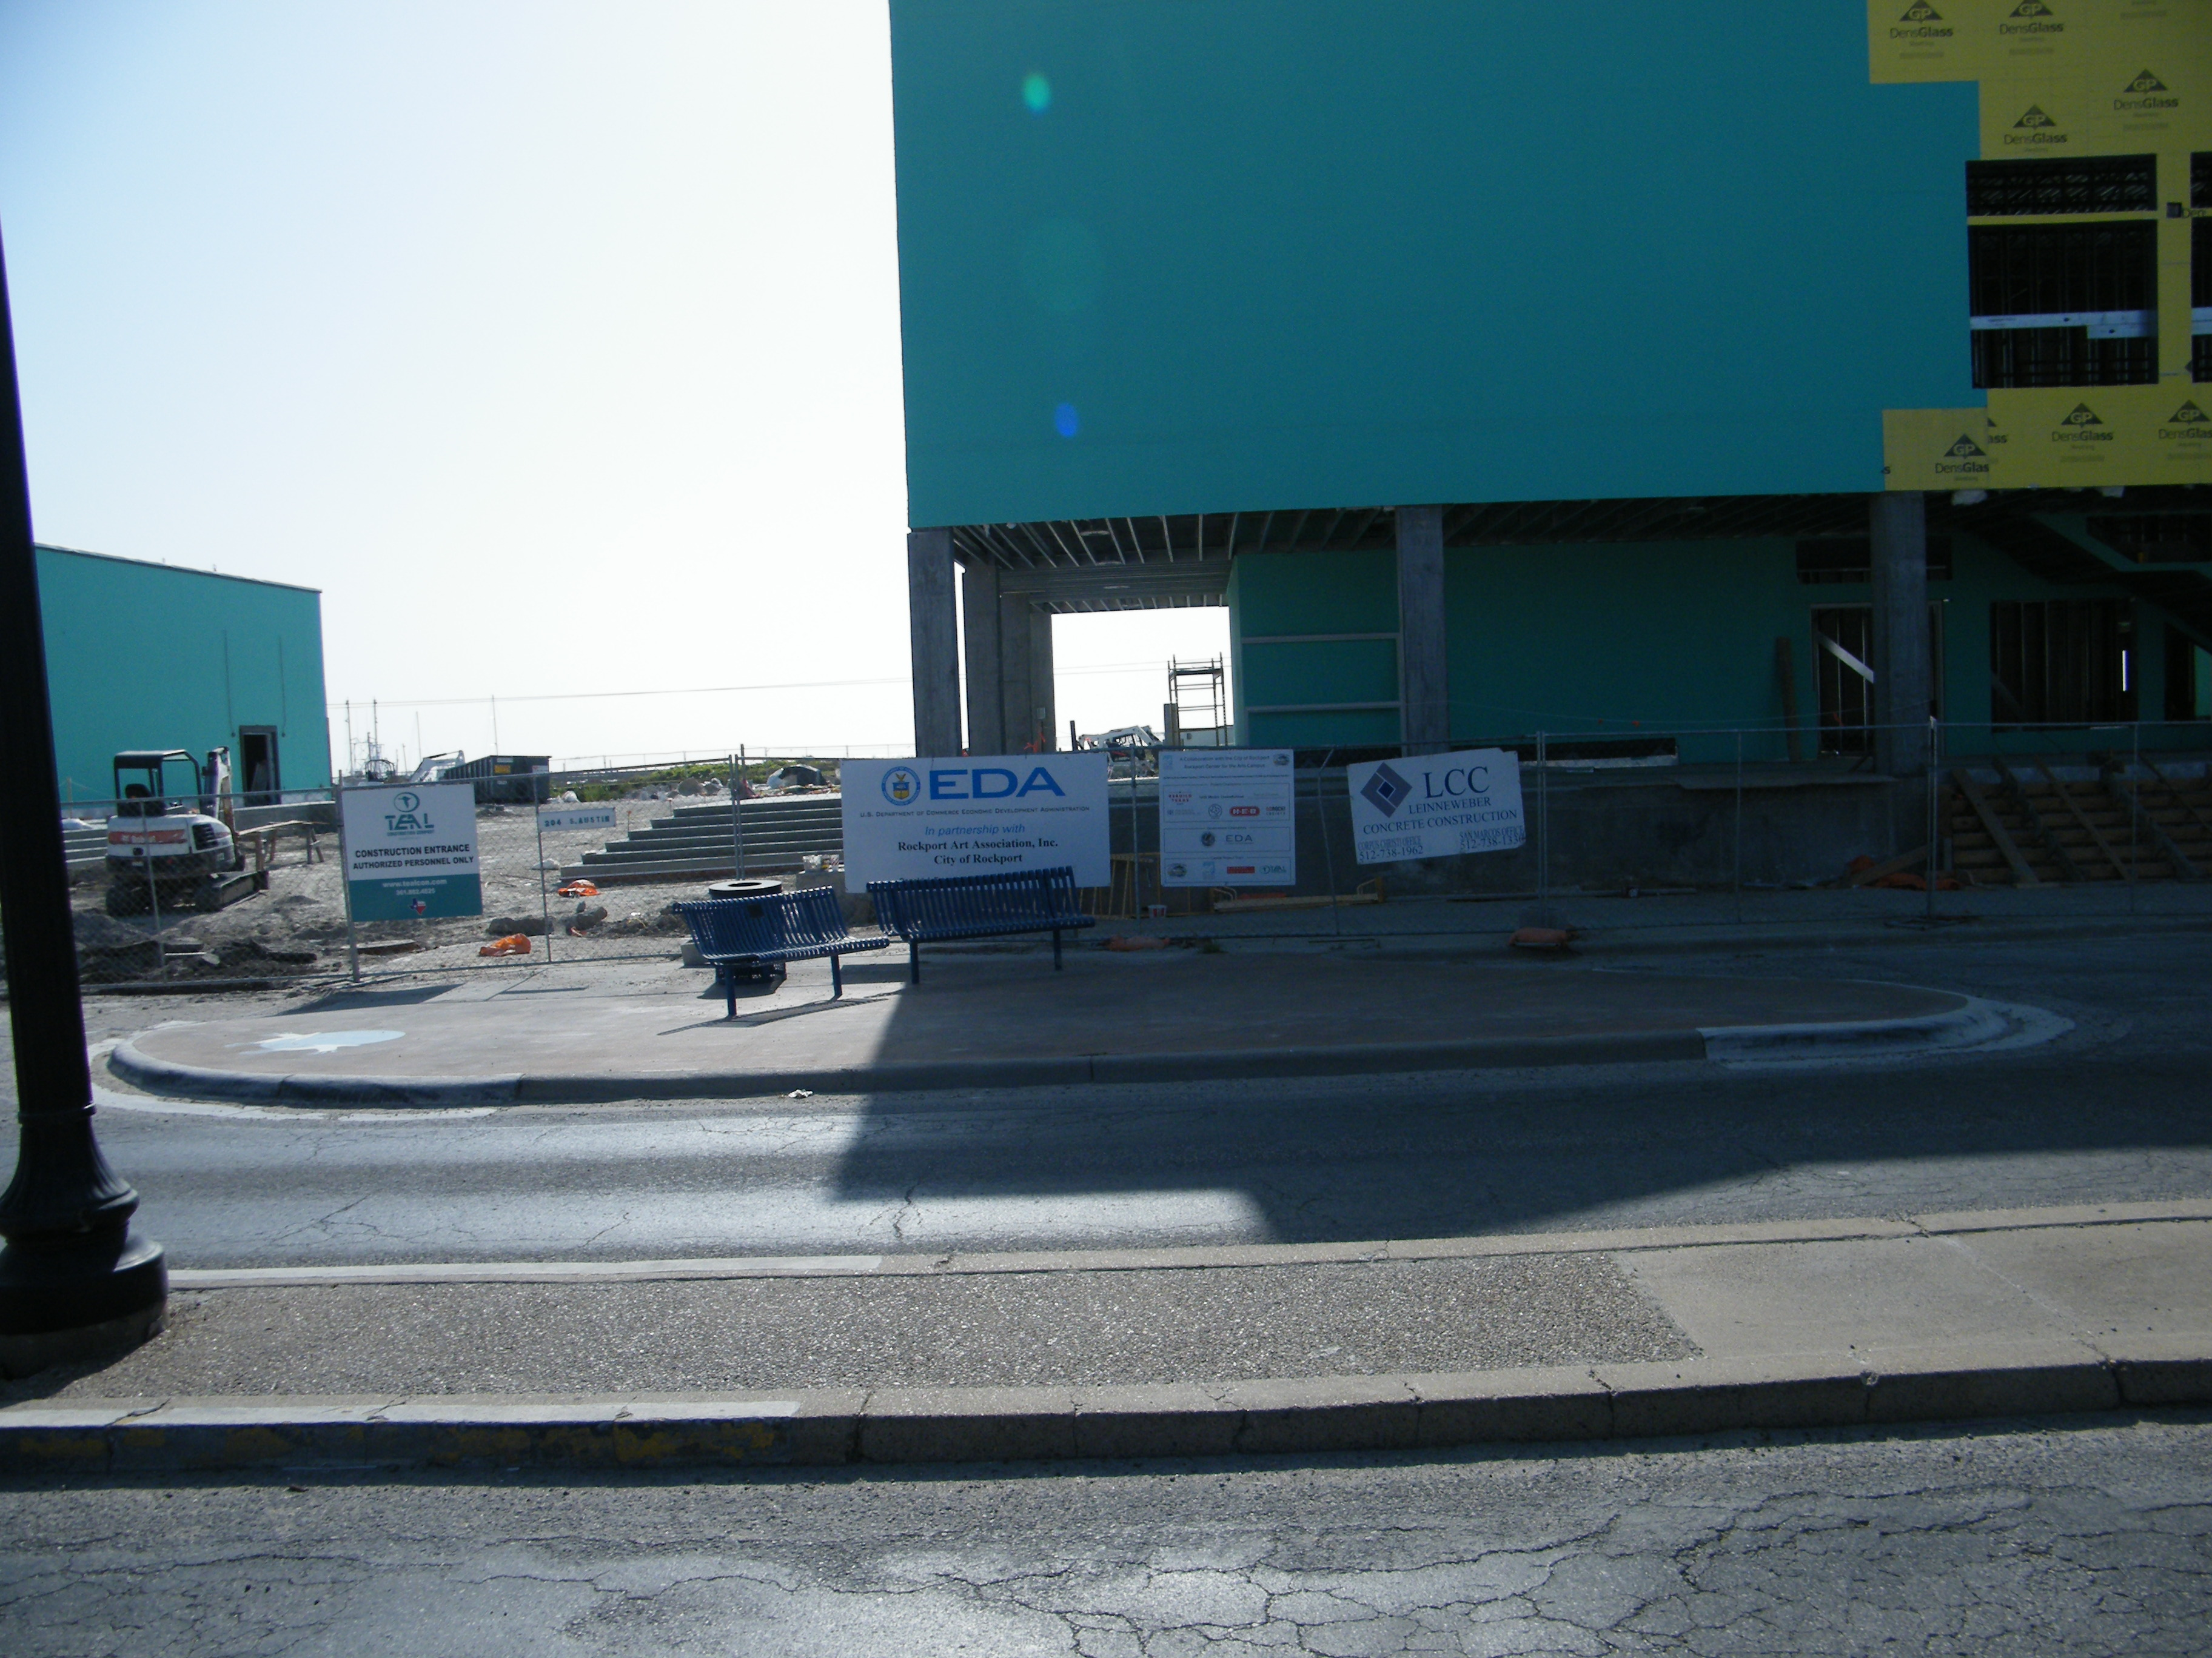
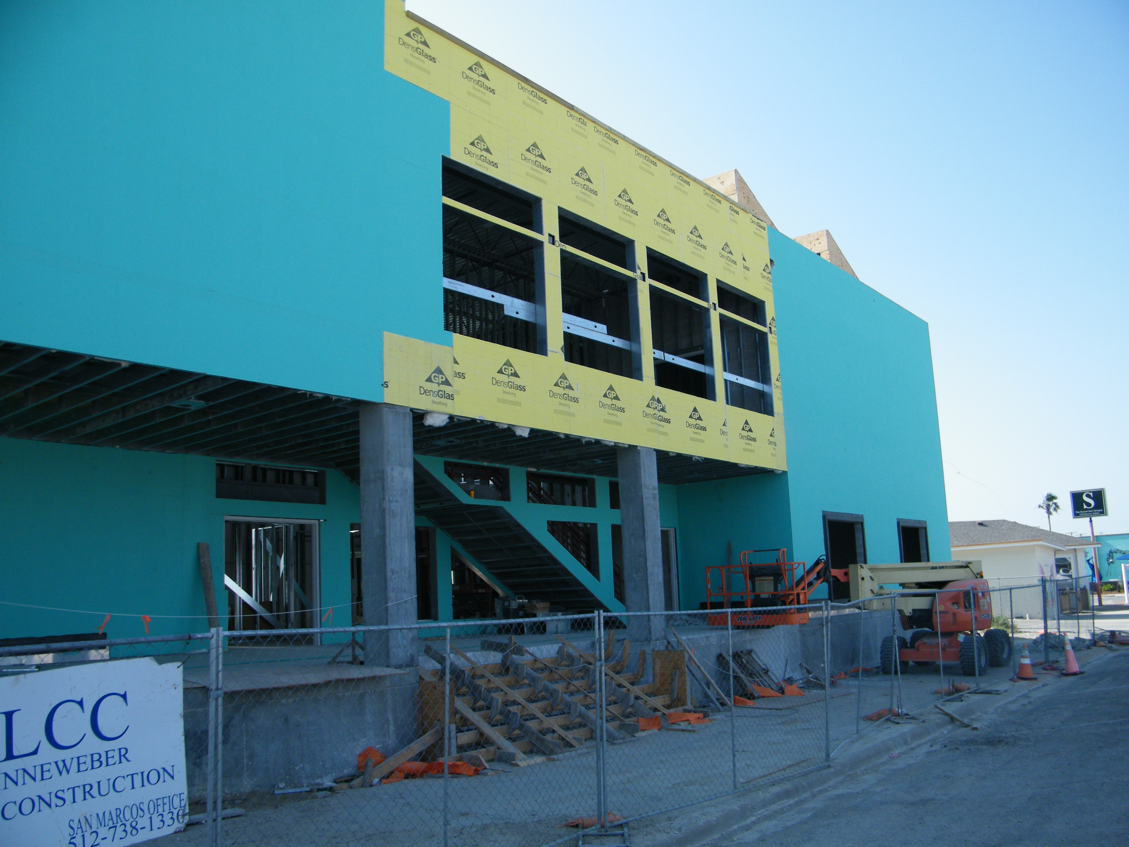
The Facilitating Our Future Series

Slide 10
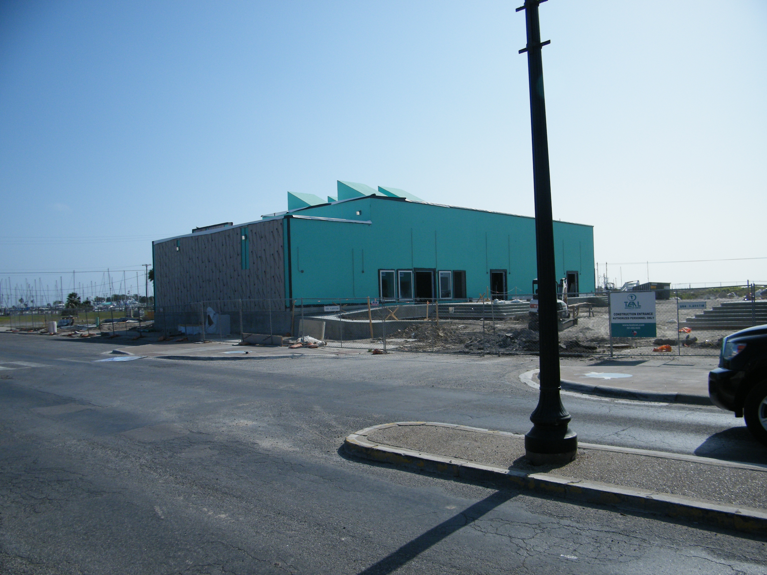
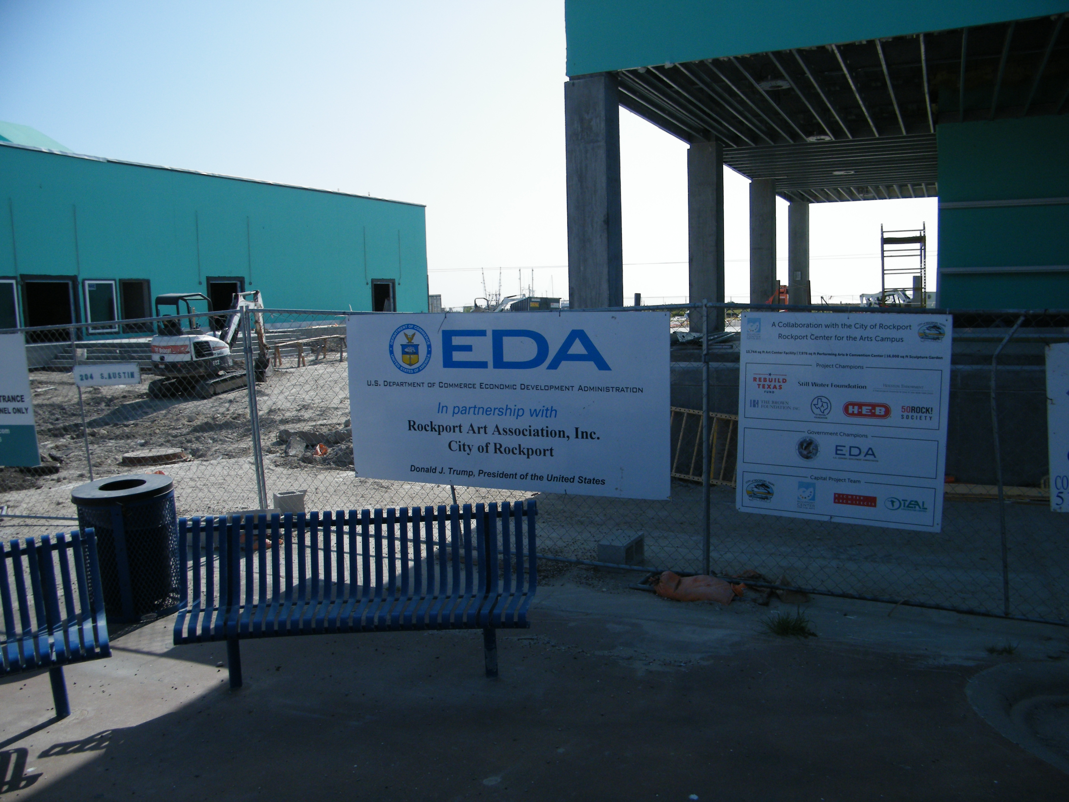
The Facilitating Our Future Series

Slide 11
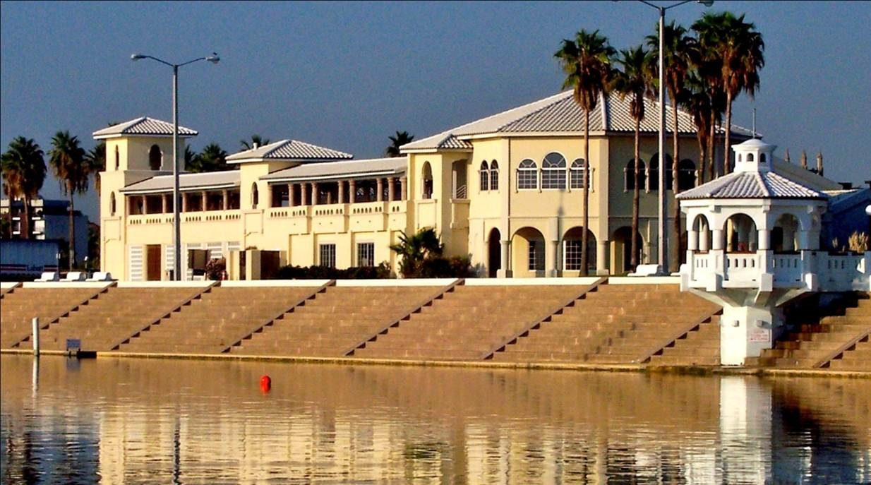
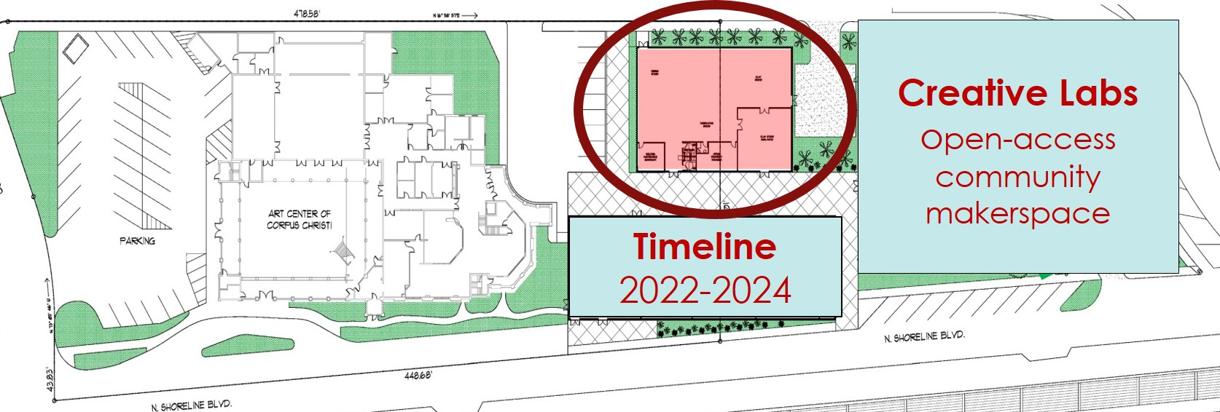
The Facilitating Our Future Series

Slide 12
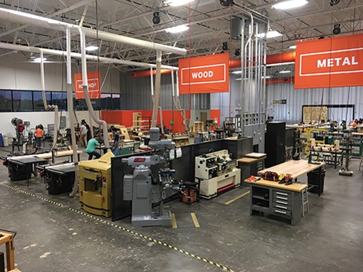
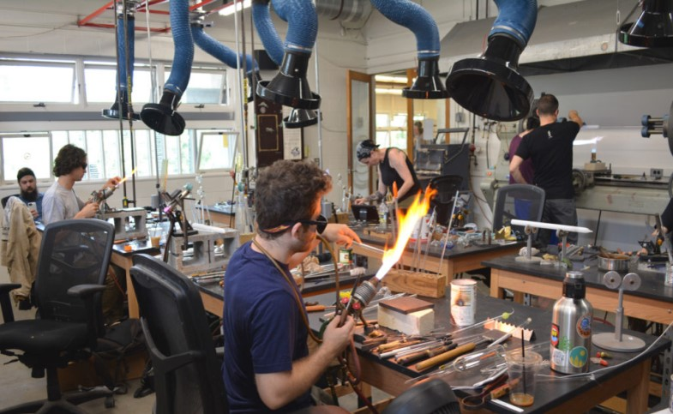
The Facilitating Our Future Series

Slide 13
The Facilitating Our Future Series

Slide 14
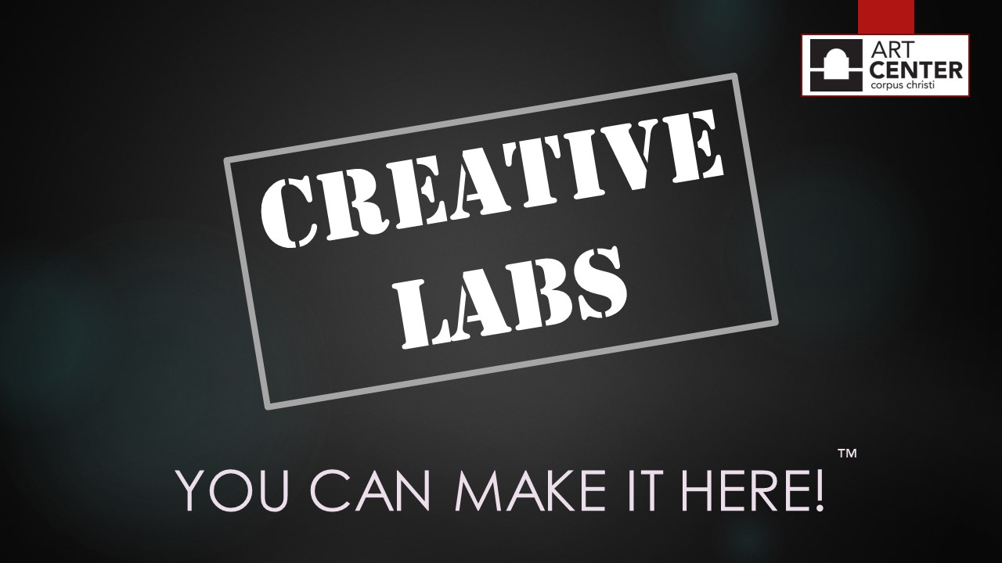
The Facilitating Our Future Series

Slide 15
The Facilitating Our Future Series
Thank You for Your Participation.
Questions and Answers

